Slide 1



ARTEMIS HACKATHON 2026
TITLE PAGE
Problem Statement No –2
Problem Statement Title- Smarter Defense Through Innovation
PS Category- Software
Team Name – NeuroCloud

Slide 2
PROBLEM STATEMENT
Rise in cyber threats, fake messages, phishing & online abuse
Students & citizens cannot easily identify risky digital interactions
Existing systems:
Collect too much personal data
Violate user privacy
Lack of real-time alerts & guidance
Real-world impact:
Financial fraud
Data breaches

Slide 3
PROPOSED SOLUTION
Smart Defense Platform
•AI-based tool to detect harmful or suspicious content
•Works on:
Emails
Messages
Social media text
•Provides:
Risk score
Actionable suggestions
•Privacy-first approach
No unnecessary data storage

Slide 4
TECHNICAL APPROACH
• Technologies Used:
Python
React/typescript (frontend)
Python / fast API (backend)
• Methodology:
Pattern & keyword detection
Risk classification
Alert generation
• Output:
Safe / Suspicious warning

Slide 5
FEASIBILITY AND VIABILITY
Uses open-source
Low infrastructure cost
Can run on cloud or local system
Easy to integrate with:
Email clients
Web apps
Scalable for large user base

Slide 6
CHALLENGES & RISKS
False positives in detection
Language & slang variations
Evolving cyber-attack patterns
User trust in AI decisions

Slide 7
IMPACT AND BENEFITS
Social Impact:
Safer digital environment
Reduced online fraud
Economic Impact:
Prevents financial loss
Educational Impact:
Improves cyber awareness
Privacy Benefit:
No excessive surveillance

Slide 8
TARGET USERS
🎓 Students
🏢 Organizations
🏛️ Government bodies
👨‍👩‍👧‍👦 General public
🏥 Hospitals & institutions

Slide 9


FUTURE SCOPE
Browser extension
Mobile app integration
Voice & image threat detection
Advanced AI explainability
Integration with national cyber portals
Multi-language support

Slide 10
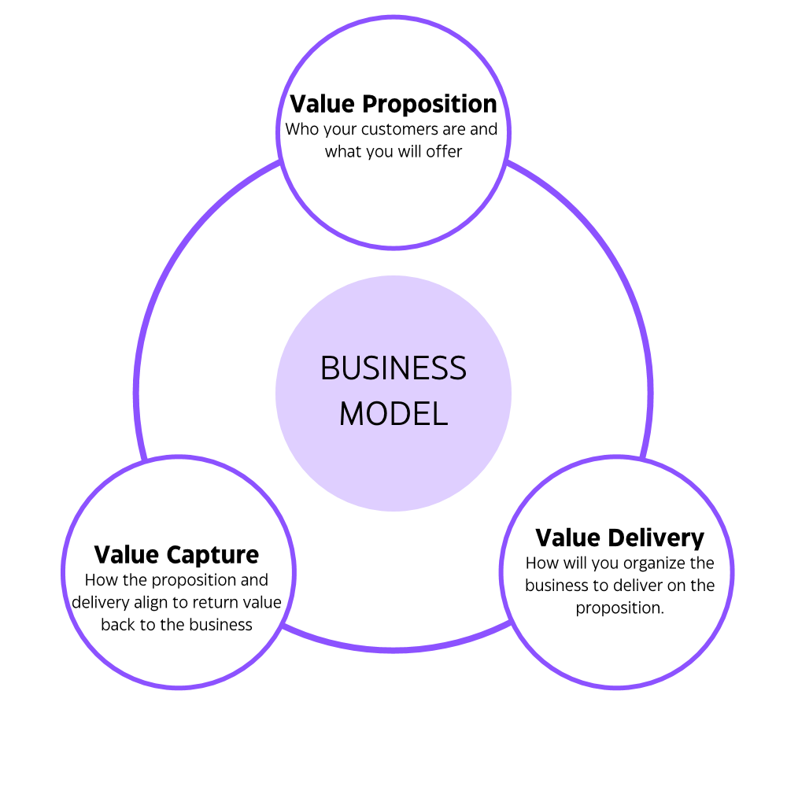
BUSINESS MODEL / PROFIT STRATEGY
• Short Ads:
Non-intrusive cybersecurity-related advertisements.
• Partner Promotions:
Sponsored content from cyber & ed-tech partners.
• Privacy-Based Ads:
Relevant ads without collecting personal data.
• Freemium Model:
Free platform with ads, optional paid ad-free version.

Slide 11

RESEARCH AND REFERENCES
Cybersecurity research papers
Open-source ML datasets
Government cyber safety guidelines
Online threat intelligence reports

